Slide 1

ECEN 3593-001 Computer Organization
Lecture #28
26 March 2021

Slide 2


Agenda
Class Announcements
Class Project Phase 8
Exceptions and Interrupts (Chapter 4)

Slide 3
Class Announcements
Reading for the week
“Computer Organization and Design, The Hardware / Software Interface, RISC-V edition,” by David Patterson and John Hennessy
ISBN 978-0-12-812275-4
Chapter 4, “The Processor”
pages 315-334 (sections 4.9 thru 4.10)
Interrupts, Exceptions and Parallelism

Slide 4
Class Announcements
Phases 5/6/7 are in the deduction period – 4%/day
Phase 8 is posted
Target Date Sunday, April 4 at 10:00 PM
Bonus 1%/day, deduction 4%/day
Homework #4 is posted – Due Date Thursday, April 1 at 10:00 PM

Slide 5
MidTerm
The MidTerm redo submissions are graded
Any reclaimed points are added in the “Fudge Factor” section in Canvas
Correct answers are enabled in Canvas

Slide 6
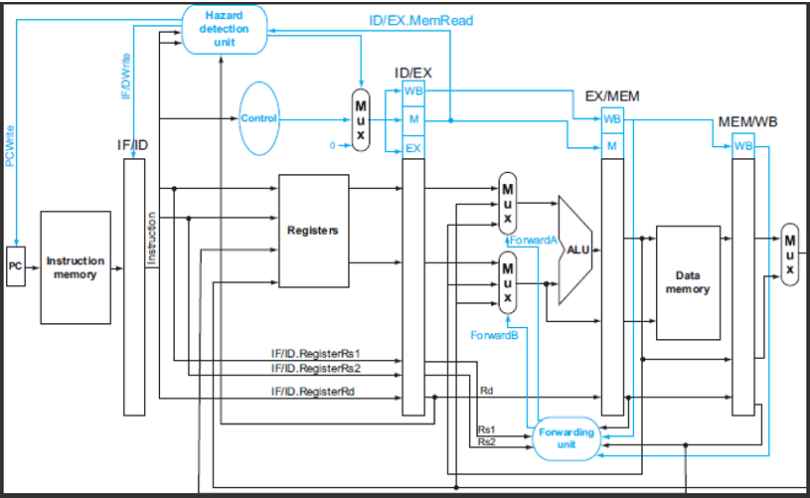
Write Data Confusion in Textbook

Slide 7
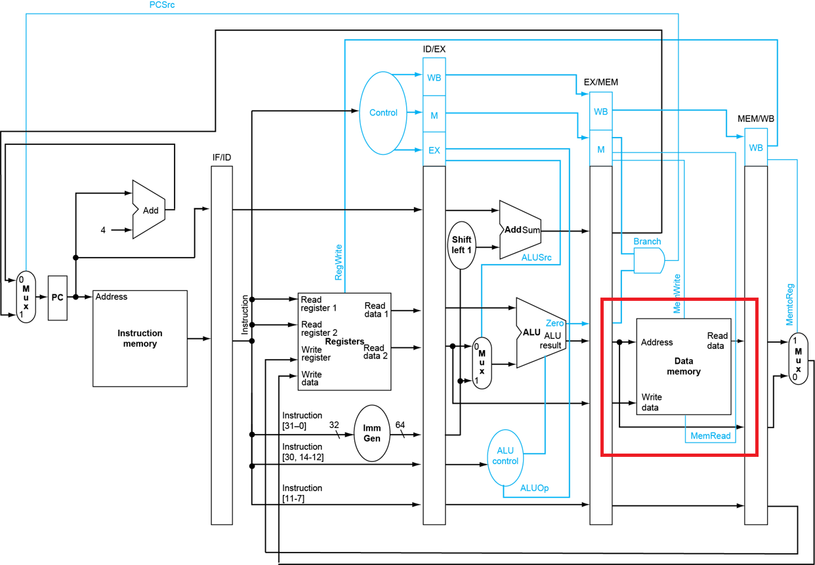
Write Data Confusion in Textbook
The previous slide omits the immediate mux
This slide omits the forwarding muxes
Real answer includes both

Slide 8
Class Project – Phase 8
Why MEMCTL?
Add a delay to the Data Memory (MAXCNT cycles)
Uses pipeline registers to hold the counter and other information
Creates s_ex_resp which indicates when data is available
Must stall until it is available
Logic controls all outputs as a function of the inputs

Slide 9
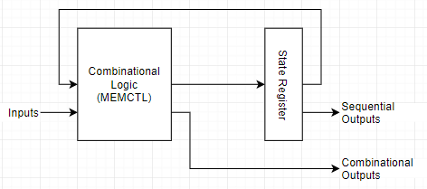
Phase 8 - What is MEMCTL?
It is a state machine which adds a configurable delay to a memory reference
Any required registers are created in the ME stage pipeline.
Some are fed back into MEMCTL
Create outputs to the ME stage

Slide 10
Class Project – Phase 8
Structure of a Control Block
out0 = fn0(in0, in1, … , inN);
out1 = fn1(in0, in1, … , inN);
out2 = fn2(in0, in1, … , inN);
…
What are fn0, fn1, etc. ?
Assignment
if/else
switch

Slide 11
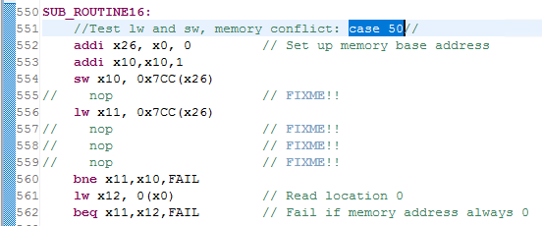
Helpful NOPs in phase8_test
The commented out NOPs can be added back as you test various stalling functions (response and load hazards)
They will all be removed in my verification test
What are we testing here?
Tests forwarding to store
Tests store/load to the same memory address
Tests the load hazard
Test memory address always 0

Slide 12
Phase 8 – Load Data Hazard
See the “Data Hazards and Stalls” part of Section 4.7 in the textbook (page 303 in the printed copy) for this function detect

Slide 13
Phase 8 - Load Data Hazards
Instruction after a load uses the data read from memory
Must stall the pipeline up to a point
Must insert a NOP (the “bubble”) at the appropriate point
This case is tested in the Phase 8 software

Slide 14
Load Data Hazard
Clock Cycle
CC0
CC1
CC2
CC3
CC4
CC5
CC6
CC7
CC8
lw x2, 100(x12)
IM
RF
DM
RF
sub x3, x1, x2
nop
IM
RF
DM
RF
stall
sub x3, x1, x2
IM
RF
DM
RF
IM
RF
DM
RF
IM
RF
DM
RF

Slide 15
Load Hazard Pipeline Flow
IF
ID
EX
ME
WB
ld x1, -20(x2)
add x2, x1, x3
Clock 1
ld
pc-1
pc-2
pc-3
pc-4
add
ld
pc-1
pc-2
pc-3
Clock 2
pc+1
add
ld
pc-1
pc-2
Clock 3
stall
hazard
Clock 4
pc+1
add
nop
ld
pc-1
MEMWB forwarding
bubble

Slide 16
Stalls and Clears
stall
stall
stall
stall
FE
ID
EX
MEM
WB
clear
clear
clear
clear

Slide 17

Stalls and Clears
Stall some of the pipeline with s_STG_stall
Only stall rightmost stage
Force NOPs with s_STG_clear
Stall overrides Clear
Can’t automatically stall the IM – how to handle?

Slide 18
ca_utils Update
Make sure to uncomment lines 36-38 below.
This will enable - - info 8 (Data Memory address), - -info 9 (Data Memory load data) and - -info 10 (Data Memory store data)
Make sure signals displayed are still correct (they should be)

Slide 19
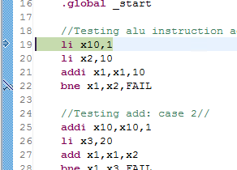
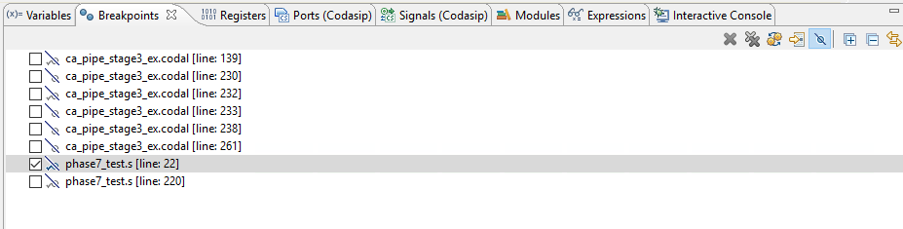
Class Project – Disabling Breakpoints
We occasionally see this and cannot set BPs
Controlled in the Breakpoint tab (toggle)

Slide 20
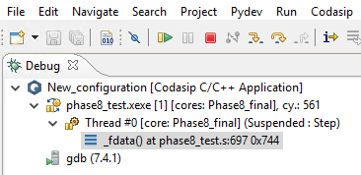
Phase 8 – Success Criteria
Register x10 must contain 57 at the end of the test
The total cycle count must be 561
https://cuboulder.zoom.us/j/4317981384

Slide 21
Exceptions and Interrupts
“Unexpected” events requiring change in flow of control
Different ISAs use the terms differently
Can be asynchronous event to the program flow
Exception
Arises within the CPU
e.g., undefined opcode, overflow, syscall, …
Interrupt
From an external I/O controller
Dealing with them without sacrificing performance is hard

Slide 22
Handling exceptions
Save PC of offending (or interrupted) instruction
In RISC-V: Supervisor Exception Program Counter (SEPC)
Used to restart the execution of the program similar to x1 for a procedure return
Save indication of the problem
In RISC-V: Supervisor Exception Cause Register (SCAUSE)
64 bits, but most bits are unused
Exception code field: 2 for undefined opcode, 12 for hardware malfunction, …
Jump to handler at 0x0000 0000 1C09 0000
To service the exception or interrupt

Slide 23
An alternative exception/interrupt handler
Vectored Interrupts
Handler address determined by the cause
Example:
Undefined opcode: 0x0000 0000
Overflow: 0x0000 0020
…: 0x0000 0040
Instructions at the vector address either
Deal with the interrupt, or
Jump to real handler
Vectored Interrupt: An interrupt for which the address to which control is transferred is determined by the cause of the interrupt or exception

Slide 24
Exception/Interrupt properties
Restartable exceptions
Pipeline can flush the instruction
Handler executes, then returns to the instruction
Refetched and executed from scratch
PC saved in a standard register (not in RF)
Interrupts may be assigned different priorities, which determines behavior for multiple simultaneous interrupts

Slide 25
What are the differences in handling an exception and an interrupt?
An interrupt can allow the current instruction to be completed - it does not need to be voided / flush since it did not result in the interrupt
It can be modelled as an unscheduled procedure call that has its own registers to return to the program flow
An exception was caused by a previous instruction – current instruction cannot be allowed to complete

